Slide 1
Summer 2018 Projects Summary
August 24th 2018

Slide 2
Projects
Copy Number Plots
Mutalyzer Lookup
Allele Frequency Noise Plots
Water Barcode Filter
Myeloid Data Entry
MSI Classification

Slide 3
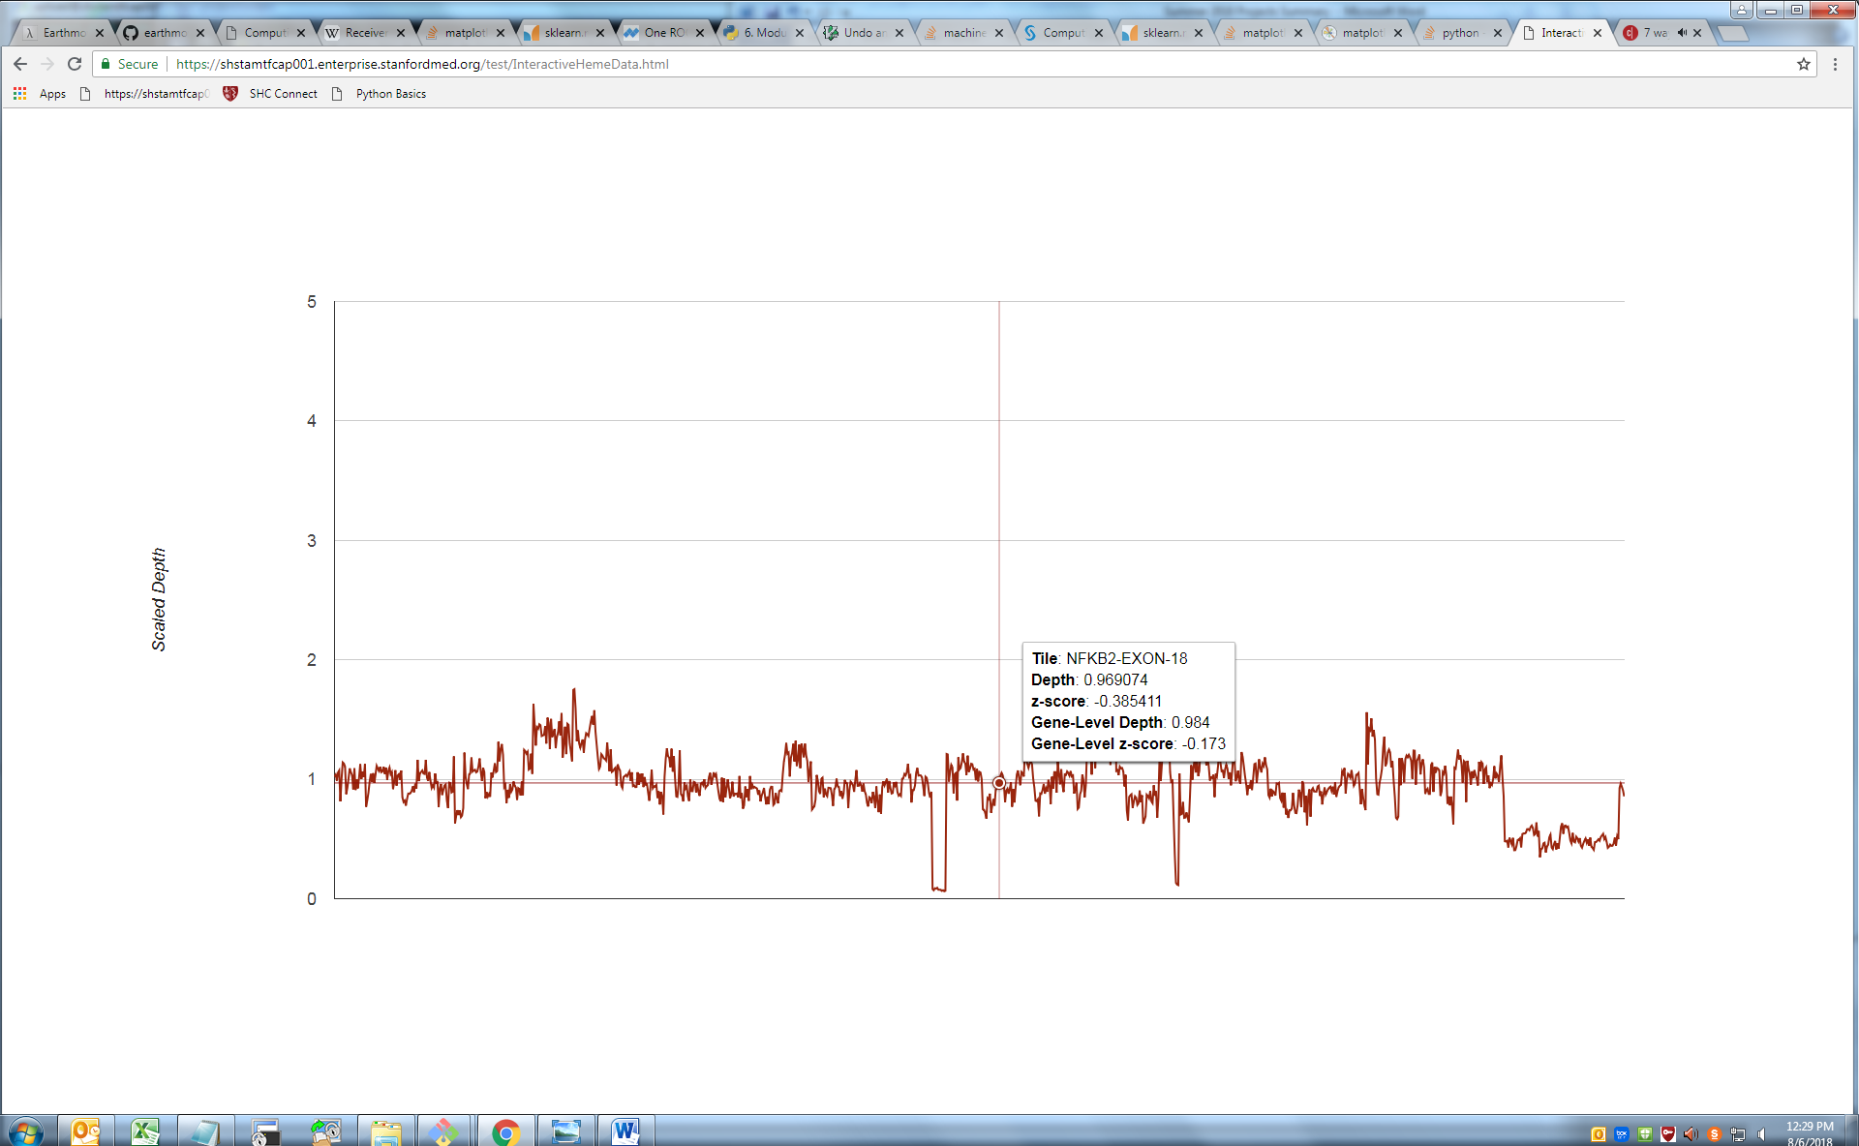
Copy Number Plots
Plots that show copy number irregularities
Include a ‘tooltip’
Depth
Z-score
Gene-level information
More easily identify copy number irregularities, on both tile and gene level
Notes:
https://shstamtfcap002.enterprise.stanfordmed.org/Heme-STAMP/sample.php?run=HEME0035-water_barcode&sample=HD701_HEME0035
Purpose was to provide additional information on the copy number plots on Heme-STAMP site
Interactive plot with tooltip to show depth and z-score as well as gene-level depth and z-score for each tile

Slide 4
Mutalyzer Lookup
Query Mutalyzer to include HGVS nomenclature base change and amino acid change in variant report
Validation script
Already being added to the pipeline
Notes:
Purpose: add the HGVS notation automatically to the variant report without the need to find the preferred transcript and query mutalyzer manually
Also wrote a validation script to identify errors in this process
Eula is already implementing this in the heme-stamp pipeline!

Slide 5
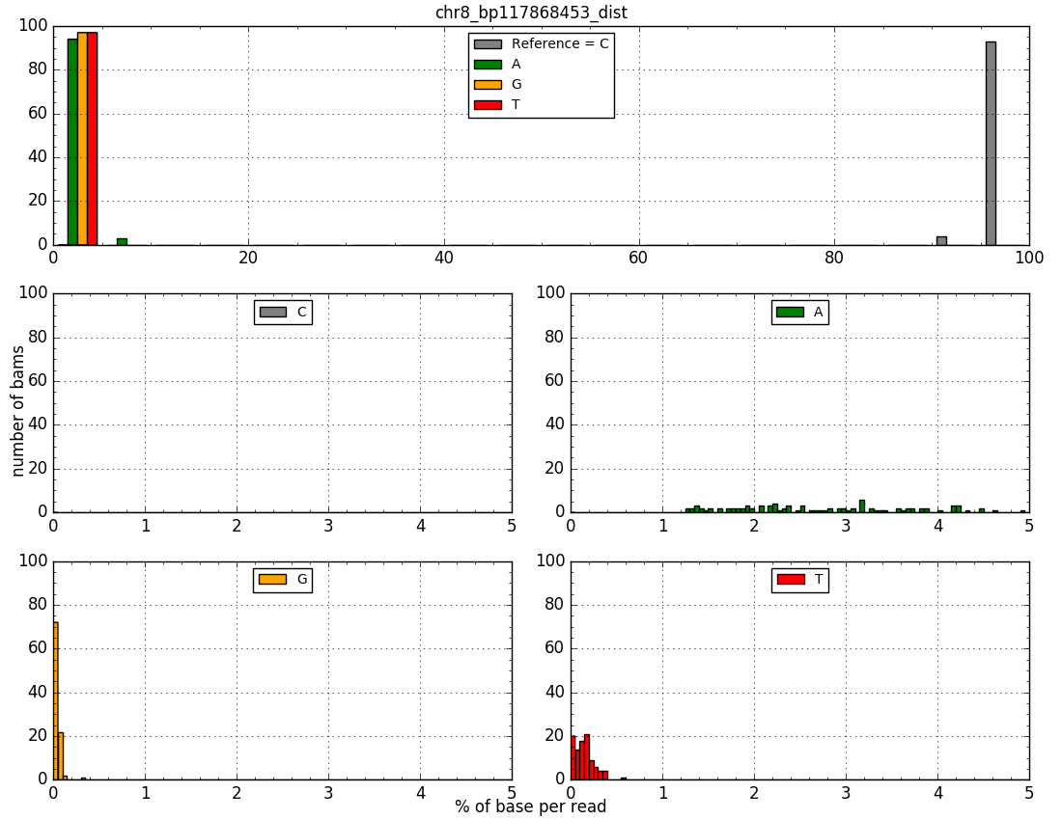
Allele Frequency Noise Plots
Quantify the frequency of each base at a user-entered chromosome and coordinate
Using 97 myeloid cases
Visually appreciate noise at certain positions to make more informed variant calls
Notes:
Purpose: to give a rough visual understanding of noise at a given position using 97 myeloid cases
Histograms showing frequency of each base at the position
Smaller histograms showing breakdown of each base’s frequency under 5% to show if the position is noisy

Slide 6
Water Barcode Filter
Search for potential contamination of the water barcode
Script maps water barcode reads to hg19 and Phix genome, filtering out mapped reads
Returns Fastq file of unmapped reads for BLAST search
Notes:
Purpose: identify any possible contaminants in the water barcode
by mapping to the human and Phix genomes separately and retaining only unmapped reads
making a fastq file of any remaining unmapped reads that can easily be BLAST searched

Slide 7
Myeloid Data Entry
Add fields containing CALR, FLT3 and CEBPA results to myeloid data spreadsheet
More robust dataset for future analysis
Notes:
Purpose: add additional information about CALR, FLT3 and CEBPAlpha results to the myeloid archive
Now this spreadsheet is more robust and useful for other projects

Slide 8
Microsatellite Instability Classification by NGS

Slide 9
Microsatellite Instability
Characterized by the “spontaneous loss or gain of nucleotides from repetitive DNA tracts”
Caused by defective mismatch repair
Is a diagnostic phenotype for certain cancer types with clinical implications
Actionable marker for immune-checkpoint-blockade therapy
(Hause et al. 2016)
Notes:
Quick background on MSI
Extension or contraction of repeats of a single nucleotide due to unnoticed polymerase slippage and defective mismatch repair
Important because knowing MSI status is clinically relevant and can influence a patient’s care

Slide 10
Microsatellite Instability
Develop a model that can accurately detect Microsatellite Instability using NGS data
Add informative loci to the STAMP selector
Clinically relevant and actionable
Notes:
The goal of this project was to develop a novel method for detecting MSI using sequencing data
In the hopes that MSI informative loci can be eventually added to the STAMP selector

Slide 11
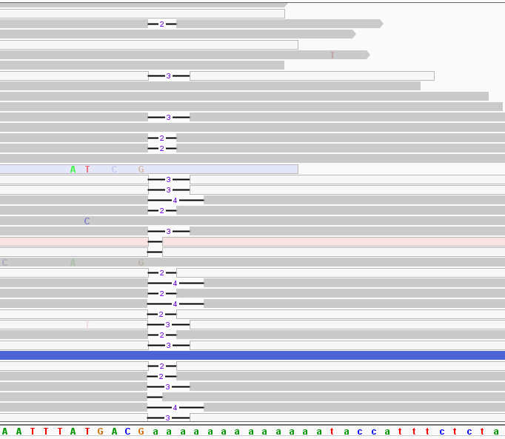
Repeat Identification
Notes:
The first step to classifying microsatellite instability is finding single nucleotide runs and figuring out how long they are on a patient-by-patient basis
27 loci Henning established from literature, fine tuning the start and end coordinates based on human genome 38
The first step is to use a python package called pysam to pull out all reads that overlap a locus’s coordinates

Slide 12
Repeat Identification
Flanking regions
Immediately adjacent to the mononucleotide repeat
7 bases long
Long enough to be unique, identifiable in individual reads
Short enough to maximize usable reads
Notes:
The next step - figure out how to determine exactly how long these regions are in each read
Easy to do for a human – look at a graphical representation, find the mononucleotide repeat by eye
Harder for the computer – took an approach similar to primers for PCR
Identify flanking regions in reference genome
then try to find them in reads mapped to the location of interest
I then had to determine how long to make the flanking regions:
- Too long and I’d have to leave out too many reads that didn’t have the full flanking region
- Too short and I could misidentify the single nucleotide run

Slide 13
Repeat Identification
Pull all reads containing bases in the region of the locus
Psyam
Scan and find flanking regions
Ordered search
First flank must be found before the second
Brute-force partial string matching
Mismatch allowance = 2
Validation: filter
Baseline = 90%
Modified for some loci
Those that contain a non-homogenous run
Notes:
Flanking regions must be found sequentially
- The ‘front’ flanking sequence must be found first
Fuzzy string matching algorithm
Allow the flanking region to have no more than 2 mismatched bases to allow for germline mutations in flanking regions
Apply a validation filter to the run that is picked out from between flanking regions
Eliminate any runs that have too many bases that don’t match the rest of the run
Some loci contain non-homogenous runs, those are allowed
Total length of the run is what matters

Slide 14
MSI Calling
Binary classifier
Simplification of MSI-H and MSI-L
Optimization
Accuracy
Sensitivity
Specificity
Notes:
The idea is to come up with a way to use the lengths of these runs to correctly decide if a person is stable or if they exhibit instability
To do this, need a method that is accurate, sensitive, and specific
ACCURACY: How many predictions did the method get right, positive or negative?
SENSITIVE: How many true positives did the method find compared to the total number of positives out there?
SPECIFIC: How many true negatives did the method find compared to the total number of negatives out there?
First method was to use locus-based calls
- each locus would be tested separately - a call would be made for each one.
- The final call would be made based on the number of stable or unstable loci

Slide 15
Machine Learning Approach
TensorFlow
Python API developed by Google
Develop a linear function that can separate the data into 2 categories
MSI or MSS
Apply function to a data point to calculate its score
Apply sigmoid function to calculate p(MSI)
Supervised learning
Classification problem
Notes:
Turns out ML is exactly the tool to do this
Can use machine learning to develop a model to make the prediction, calculate an exact probability that a given sample is unstable

Slide 16
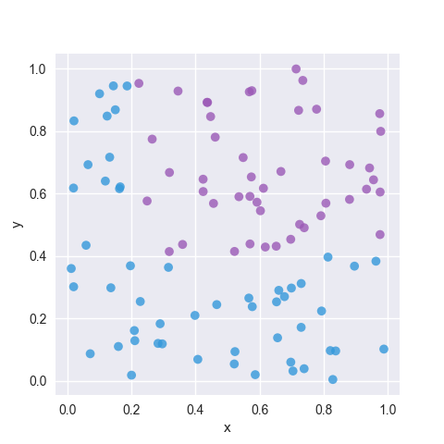
Google’s ‘ML Crash Course’
Finding the best ‘best-fit line’ to distinguish two groups of data
Minimizing error
Notes:
Basic Idea of ML:
Separate two populations of data using their characteristics, or ‘features’, by drawing some sort of line between them
- minimize the error
The line shown here is good, but is there a better line?

Slide 17
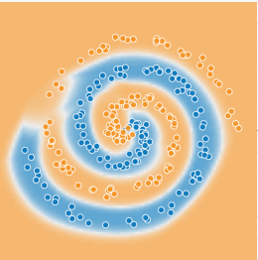
Google’s ‘ML Crash Course’
Finding the best ‘best-fit line’ to distinguish two groups of data
Minimizing the error
Notes:
More sophisticated models can create non-linear ways of separating the data
A type of sophisticated machine learning is neural networks, which attempt to recreate the way the human brain processes information
Neural net-created image on the left

Slide 18
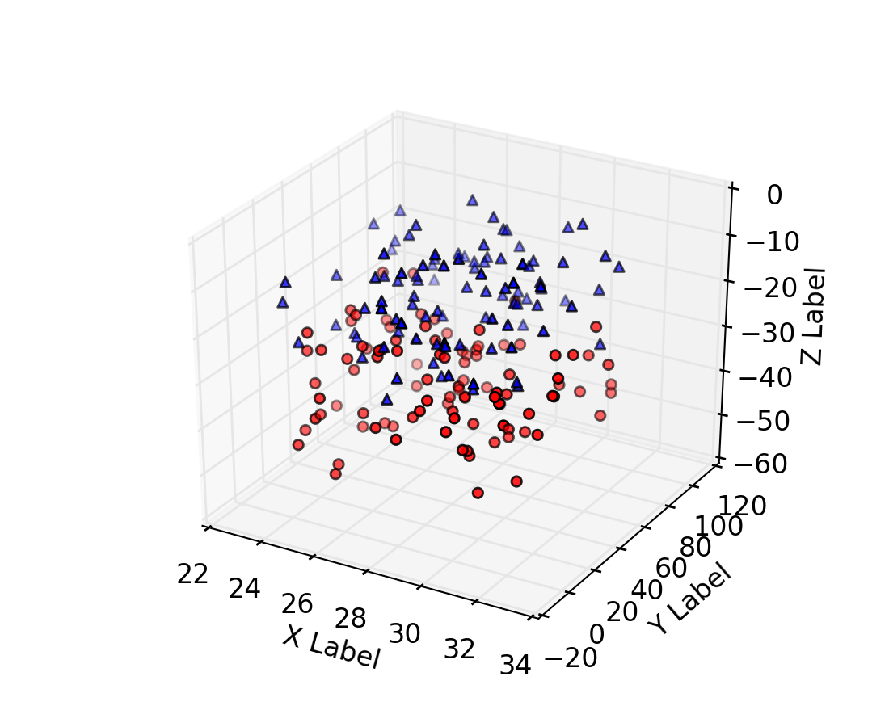
Google’s ‘ML Crash Course’
Finding the best ‘best-fit line’ to distinguish two groups of data
Minimizing the error
ML allows expansion of this idea to n-dimensions
Notes:
Until now, we’ve been looking at datasets that have 2 features, x value and y value
What if there were 3 features to consider, like a z-label
Still possible to imagine in 3 dimensions, with some kind of curved plane separating the two sets
The real power of ML is to extend this idea into n-dimensions

Slide 19
Machine Learning Approach
Locus-based calls
Develop a linear model using ML for each locus individually
Overall call based on the proportion of all 27 loci that are unstable
Simplification
7 loci with high number of BAMs with reads available, good depth at the loci
Initial proof of concept
Notes:
To do this, I used google’s tensorflow, a python package that does the ML steps
Create a linear functions based on weights of each feature being considered, then apply a sigmoid function to get a (0, 1) probability of MSI
Do this 5 times for 5 separate loci, then conclude

Slide 20
MSI Calling - Features
Number of lengths
[11, 12, 11, 13, 14] = 4
Distance from mode
Average distance from MSS sample mode of all reads
Standard deviation
Average Length
Notes:
Features are the dimensions of the model, the numerical characteristics that define a data point
The features that were used in my model were all gathered from the different run lengths recorded and attempt to quantify the different distributions of lengths of the two statuses
Number of distinct lengths
Mode was calculated using a separate set that was not used to train or test the model

Slide 21
Datasets
All files
602 BAM files with MSS, MSI-L or MSI-H annotation
241 COAD-READ, 361 UCEC
212 MSI, 390 MSS
Mode training set
Randomly generated set of 100 BAM files with MSS status to generate mode length
43 COAD-READ, 57 UCEC
0 MSI, 100 MSS
Notes:
Part of ML is dividing the data into different sets
First set was just used to come up with a most frequently occurring value, or mode, for each locus

Slide 22
Datasets (continued)
Training Set
300 BAM files of mixed status to train the model
118 COAD-READ, 182 UCEC
130 MSI, 170 MSS
Validation Set
100 BAM files of mixed status to validate the model
44 COAD-READ, 56 UCEC
40 MSI, 60 MSS
Test Set
102 remaining BAM files of mixed status to test the model
36 COAD-READ, 66 UCEC
42 MSI, 60 MSS
Notes:
Training set is the largest and was used to train the model
- Labeled
Validation set was used to see how well the model was working in order to tweak and improve it
Test set was used to test the model after tweaks were made
The sets are all roughly representative of the overall population

Slide 23
Datasets (continued)
Randomly generated sets
Representative of both cancer types
Low coverage problem
Low coverage at certain loci excludes some files from some locus analyses
Actual size of datasets vary based on individual BAM coverage at any given locus
Notes:
Training, validation and test sets all randomly generated from the full dataset and represent both cancer types and both MSI statuses
At some loci, some BAM files had to be excluded if coverage was too low (0), changing slightly the size of training and validation sets at certain loci

Slide 24
Locus-Based Calling
Generate ML model for each locus individually
Weight for each feature, bias
Sigmoid activation function to generate p(MSI) in range (0, 1)
Choose loci with highest AUC
Exclude those that have no reads in many BAM files
Try different combinations of loci
Determine MSI status based on number of loci with ‘MSI’ call
Notes:
Use ML via tensorflow to generate a model for each locus, sigmoid function to convert the result of the linear function into a probability in the range 0, 1
Simplify to 7 loci, but which 7?
- Choose loci with good coverage in majority of training set files
- Choose loci that are good predictors of MSI status
- determined by looking at AUC, which measures how good a model is

Slide 25
Locus-Based Calling (continued)
Loci examined
BAT-26
MSI-07
MSI-09
H-06
MSI-06
MSI-04
HSPH1-T17
Threshold: 0.500000
Min no. loci: 4
Total files: 93
Correct predictions: 78
True pos: 24
True neg: 54
False pos: 2
False neg: 13
Accuracy: 0.838710
Sensitivity: 0.648649
Specificity: 0.964286
Notes:
This is the result from locus based calling
The accuracy was fair, 83% of cases were called correctly using the model
But the real problem was the sensitivity – there were too many false negatives.
The obvious answer for what to do to balance sensitivity and specificity is to adjust the threshold, but since I applied a sigmoid function to the linear model, the final ‘score’ is a probability and it doesn’t make sense to adjust the threshold when using a probability

Slide 26
Probability-Based Calling
Generate ML model for each locus individually
As before
Choose loci with highest AUC
As before
Determine MSI status based on average p(MSI) across loci examined
Notes:
So instead, I decided to investigate these same 7 loci but take into consideration their probability of being MSI
This is slightly confusing so I made an example

Slide 27
Probability-Based Calling (example)
BAM file: TCGA-00-0000
BAT-26
p(MSI) = 0.998
MSI-07
p(MSI) = 0.488
MSI-09
p(MSI) = 0.478
H-06
p(MSI) = 0.499
MSI-06
p(MSI) = 0.898
MSI-04
p(MSI) = 0.978
HSPH1-T17
p(MSI) = 0.408
Locus-based call: MSS
3 MSI, 4 MSS
Probability-based call: MSI
Avg p(MSI): 0.678
Notes:
So for example, I made this fake case that is an exaggeration of what I was noticing
In this case, 3 of the 7 loci examined were close to a 100% probability of being unstable, while 4 loci were under the threshold of .5
A locus-based call could over-simplify this information indicate that this sample is stable,
while a probability-based call would show that this case is unstable

Slide 28
Probability-Based Calling (continued)
Loci examined
BAT-26
MSI-07
MSI-09
H-06
MSI-06
MSI-04
HSPH1-T17
Threshold: 0.500000
Total files: 93
Correct predictions: 78
True pos: 23
True neg: 55
False pos: 1
False neg: 14
Accuracy: 0.838710
Sensitivity: 0.621622
Specificity: 0.982143
Notes:
With the probability-based method, there were the same number of correct predictions, but slightly worse sensitivity and better specificity.
This naturally led me to my next idea –

Slide 29
Probability-Based Calling (continued)
Problem: some loci may be more indicative of MSI status than others
Need weights assigned to each measure at each locus individually
Notes:
what if some loci were more indicative of MSI status than others?
Basically, I needed to assign weights to each locus individually

Slide 30
A Bigger ML Problem
Solution: instead of individually looking at one locus with m features, consider all n loci with all m features at once
Machine learning problem in n x m dimensions
Exclude loci with too few usable files
Notes:
The solution to that problem is to look at a much bigger machine learning problem: N loci with M dimensions each, for a total of N by M dimensions
27 loci X 4 features each = 108 dimensional problem
Some Loci had very low coverage in the majority of cases, so I excluded them
I ended up with 21 loci, giving an 84-dimensional ML problem

Slide 31
Benefits
Can report a probability instead of a binary call
Easy to add new loci
Will be considered relative to other loci
Easy to choose the most relevant loci
Defining a selector for STAMP
Notes:
The benefit to this kind of analysis is that it provides detailed information.
the output is a single probability, which is much more intuitive to work with than locus-based calls
A single call is also more flexible than locus-based calls: it’s easy to add new loci and see how they compare to other loci in terms of how indicative of MSI status they are
Also, practically speaking, this analysis can help to pinpoint the most important loci, which is important when choosing loci to add to the STAMP selector

Slide 32
Machine Learning v2 – Setup
21 loci x 4 features each
84-dimensional model
Training Set
266 cases
124 MSI, 142 MSS
Validation Set
87 cases
33 MSI, 52 MSS
Test Set
93 cases
38 MSI, 55 MSS
Notes:
So this is the setup for my second attempt at machine learning
21 loci with 4 features each gives an 84-dimensional model
Note that the number of cases in each set is slightly lower, since those that did not have reads at every locus had to be omitted

Slide 33
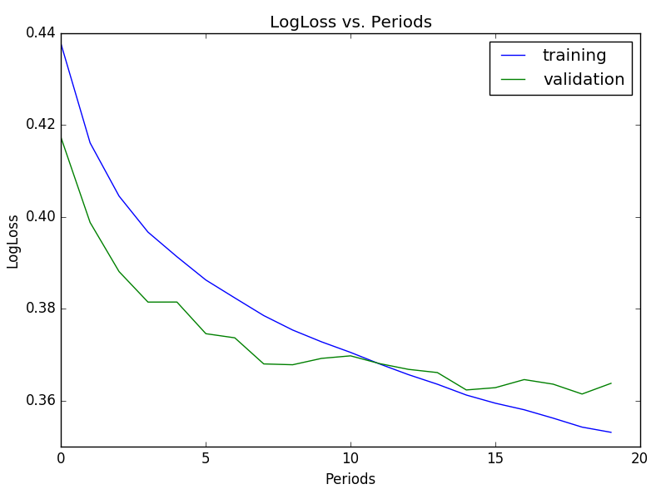
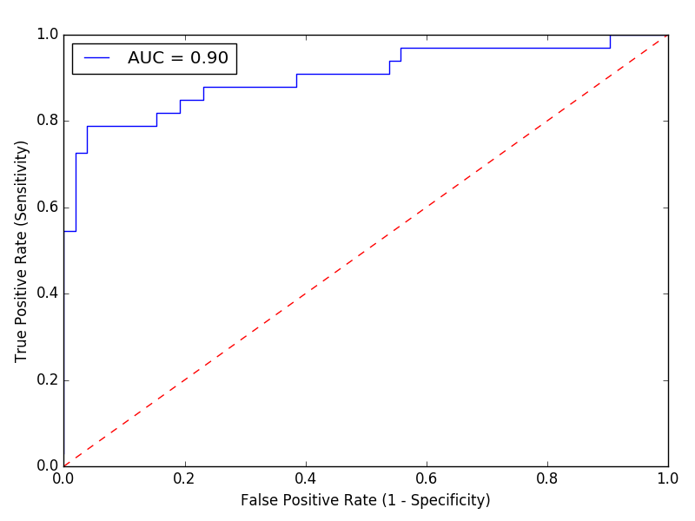
Machine Learning v2 - Results
Learning rate = 0.01
Steps = 200,000
Batch size = 10
Overfitting?
Notes:
This is the output of the machine learning.
The first plot shows the loss, or the error, that we’re trying to minimize as the model learns. The blue line shows loss over iterations of learning for the training set, and the green shows the validation set
The Second plot is an ROC curve, which plots the sensitivity versus 1 minus the specificity for the validation data. The red line represents the plot that would come from random guessing
The first plot, however, shows one of the potential problems that can arise from machine learning. It’s here
This point where the lines for training and validation overlap demonstrate that the model continues to get better on the training data, but not on the validation data. This could potentially be due to what’s called overfitting, or choosing a model too specific to the training data.

Slide 34
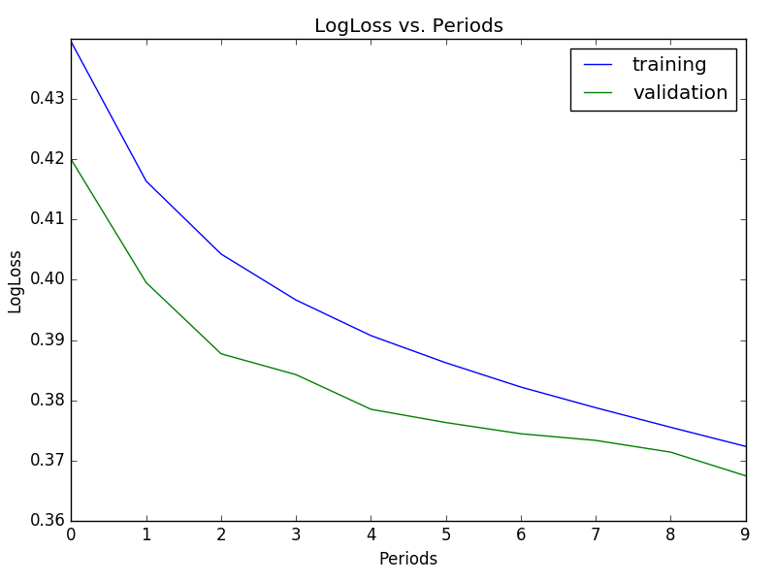
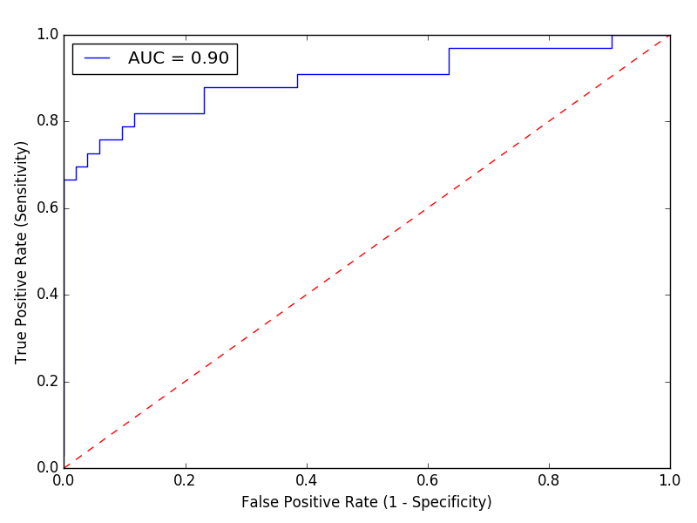
Machine Learning v2 - Results
Learning rate = 0.01
Steps = 100,000
Batch size = 10
Notes:
Instead here, I used half the number of iterations, stopping the training before the model starts to overfit. I used the results from training this model for the rest of the experiments

Slide 35
Machine Learning v2 – Test Set
Loci examined
MSI-11
MSI-14
H-10
HSPH1-T17
BAT-26
BAT-25
MSI-04
MSI-06
MSI-07
MSI-01
MSI-03
MSI-09
H-09
H-08
H-01
H-03
H-02
H-04
H-07
H-06
H-05
Threshold: 0.500000
Total files: 93
Correct predictions: 76
True pos: 28
True neg: 48
False pos: 7
False neg: 10
Accuracy: 0.817204
Sensitivity: 0.736842
Specificity: 0.872727
Notes:
Was able to get good accuracy, sensitivity and specificity using the .5 threshold The accuracy is similar to that of previous tests.

Slide 36
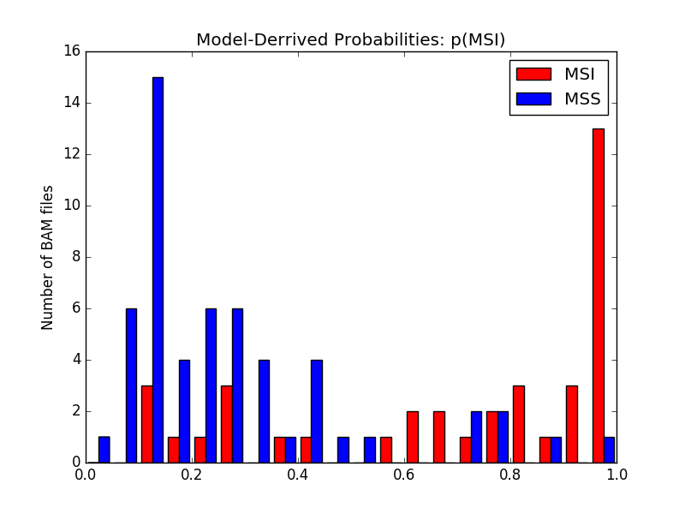
Machine Learning v2 – Test Set
Notes:
Bimodal distribution – what if instead of using one threshold we use two, and make an ‘indeterminate’ classification for cases that are too close to call?

Slide 37
Machine Learning v2 – Test Set
Loci examined
MSI-11
MSI-14
H-10
HSPH1-T17
BAT-26
BAT-25
MSI-04
MSI-06
MSI-07
MSI-01
MSI-03
MSI-09
H-09
H-08
H-01
H-03
H-02
H-04
H-07
H-06
H-05
Upper threshold: 0.550000
Lower threshold: 0.450000
Total files: 93
Indeterminate files: 2
Predictions: 91
Correct predictions: 75
True pos: 28
True neg: 47
False pos: 6
False neg: 10
Accuracy: 0.824176
Sensitivity: 0.736842
Specificity: 0.886792
Indeterminate: 2%
Notes:
Marginally better accuracy, but lose calls for 2 patients
This could work better for sets with more data, helping to decide the two threshold values for making the indeterminate call

Slide 38
Summary
Best AUC of ≈90%
Measures the predictive ability of the model
Maximum accuracy of ≈82% on test set
Slightly more accurate on called cases if ‘indeterminate’ status is allowed
Machine learning using all loci and all features is likely the best option
More samples with better depth to train on
Notes:
Most success found using ML on all loci at once
AUC is a commonly-used measure of how well the model works
82 percent accuracy is low for a clinical test, but seems to be kind of cap given low training, test and validation set sizes

Slide 39
Further Investigations Improve Existing Model
Get more BAM files
Training, validation and test sets are stale
Get BAM files with better coverage for more accurate results, better prediction
Research clinical relevance of MSI diagnosis
Fine-tune parameters to favor either false positives or false negatives
Regularization
L2 regularization
Penalizes any weight that is too large, drives weights asymptotically to 0
L1 regularization
Penalizes total weight of all features, drives non-informative weights to 0
Notes:
As I mentioned before, there’s a risk of overfitting to the training data.
Additional BAM files would reveal more ways to improve the model
The threshold at which to call MSI determines the number of false positives or false negatives
More research into the clinical implications of this diagnosis would dictate whether a more conservative or more liberal approach to calling is better
Regularization can be very useful in filtering out what features are most informative
L1 might be best
Each set of features is an addition to the STAMP selector

Slide 40
Further Investigations Expand Existing Model
Add features
Earth mover distance
Add a label for ‘MSI-L’ and ‘MSI-H’
Investigate more loci
Hause et al. used 223,082 microsatellite loci to develop a MSI calling method with 96.6% accuracy
Train using matched normal samples
Detect low, baseline level of MSI in tumor samples
Notes:
EMD is a way of comparing the distance between two distributions
Could be a useful feature to try out
Literature has used MSIL and MSIH terminology
More loci = more data, but minimizing number of loci to most important ones might be more practical for targeted sequencing application
Compare tumor to matched normal samples to detect baseline MSI

Slide 41
Further Investigations Investigate New Models
Linear classifier models using different features
Feature crosses
Neural nets
Multi-class neural nets
Require more training, validation and test data, overfitting concern
Notes:
More complicated machine learning methods might significantly improve the model
Feature crosses involve multiplying two nonlinear features together to get a linear feature
Neural nets
More complicated machine learning that uses hidden layers to find patterns in data
These would be interesting things to try if we had a lot more data: more BAM files and better depth at the relevant loci

